Slide 1
Ulinkers
Midterm Presentation
Teh Kaixin
Nicole Goh
Sean Kwok
Nabilah Banu
Chien Shu Yan

Slide 2
Agenda
Introduction
Problem and Solution
Technologies
User Testing
Project Management
X-Factor
Reflections
Introduction
Problem and Solution
Technologies
User Testing
Project Management
X-Factor
Reflections

Slide 3






Nicole Goh
Teh Kaixin
Project Manager
Deputy Quality Assurance
Nabilah Banu
Lead Frontend Developer
Deputy Project Manager
Business Analyst
Deputy Frontend Developer
Sean Kwok
Chien Shu Yan
Lead Backend Developer
Lead Quality Assurance
Introduction
Problem and Solution
Technologies
User Testing
Project Management
X-Factor
Reflections

Slide 4



Operating since 1996
Our Sponsor
Medical concierge provider:
Clinic & hospitalisation arrangements
Treatment plans & price estimates
Travel arrangements & visas
Standby assistance in Singapore
Linda Siow, Executive
Patients:
Indonesia, Malaysia, Cambodia, Vietnam, Myanmar & China
Makes more than
1000 appointments every year

Slide 5
Problem
Unable to keep track of teams’ performances
Tedious process to follow up with existing clients
Views are not optimised
Difficult to determine engagements with stakeholders
Unable to customize reports with required fields
No consolidated overview of required reports
Difficult to target clients to email recommended screenings using current system
Introduction
Problem and Solution
Technologies
User Testing
Project Management
X-Factor
Reflections

Slide 6
Solution
Ulink Web Application
Reporting tools for decision making
(Specific KPI of different teams, Gender and Age, Ranking of stakeholders, Index (points)
1
2
Screenings recommendation and reminder
3
Dashboard displays statistics and overview
Optimised views
(reduce duplicates, group by client name)
4
Introduction
Problem and Solution
Technologies
User Testing
Project Management
X-Factor
Reflections

Slide 7
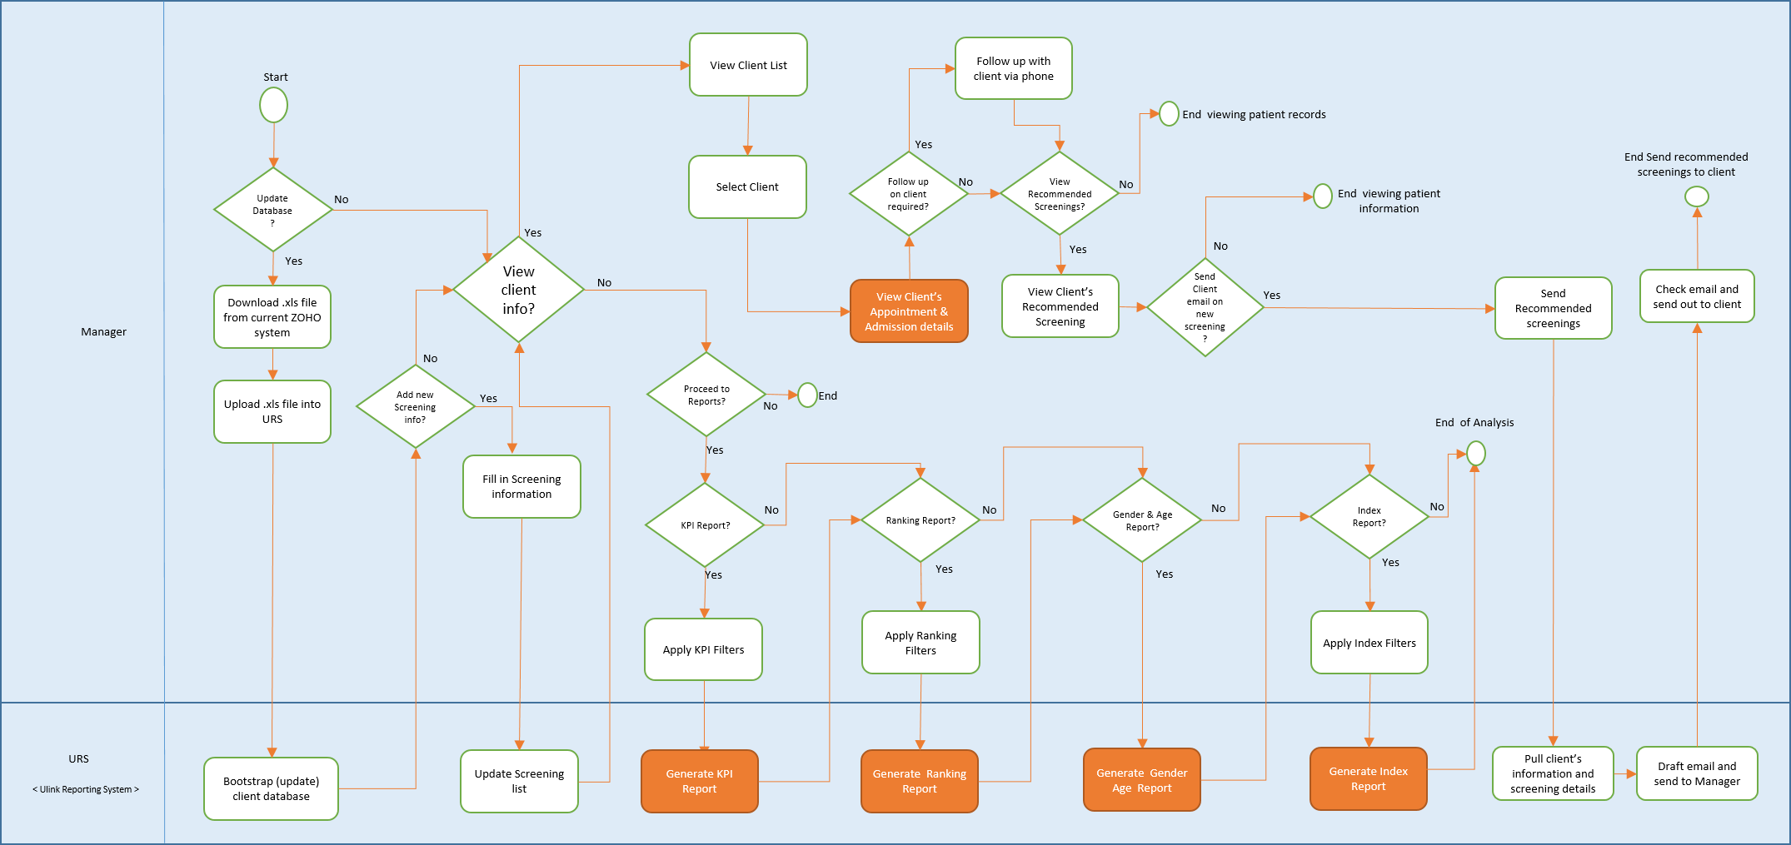
Solution
To-Be Workflow
Introduction
Problem and Solution
Technologies
User Testing
Project Management
X-Factor
Reflections

Slide 8






Market Research
 | Ulink Reporting System
Screening Recommendation based on client’s profile
Reports functions (Team’s performance)
Ranking (Stakeholder engagements)
Client Management (Profile view of each client)
Introduction
Problem and Solution
Technologies
User Testing
Project Management
X-Factor
Reflections

Slide 9

DEMONSTRATION
Introduction
Problem and Solution
Technologies
User Testing
Project Management
X-Factor
Reflections

Slide 10

Technology
Architecture Diagram
Technical Complexity

Slide 11











TECHNICAL
Architecture Diagram
FRONTEND
HTTP GET POST JSON
BACKEND
OTHER SERVICES
JSON OUTPUT
Introduction
Problem and Solution
Technologies
User Testing
Project Management
X-Factor
Reflections

Slide 12
TECHNICAL
Technical Complexity
Do you have a diagram that shows all the components/module/3rd party tools/framework/API/design pattern of your code?
Is it a client server system? Are the data pulled or pushed?
How flexible/maintainable is your system? Is it hard-coded or uses configuration files?
https://wiki.smu.edu.sg/is480/img_auth.php/0/0c/Chosen6-midtermslidesfinal2.pdf
e.g. USABILITY ๏ Problem: Different platform and screen size creates misalignments. ๏ Solution: Customised codes to work on multiple platforms and screen sizes.
Security = hash password
Bootstrap takes a long time
๏ Problem: Information from database takes awhile to load. ๏ Solution: Call database once to get all information to decrease waiting time
Introduction
Problem and Solution
Technologies
User Testing
Project Management
X-Factor
Reflections

Slide 13

Project Management

Slide 14
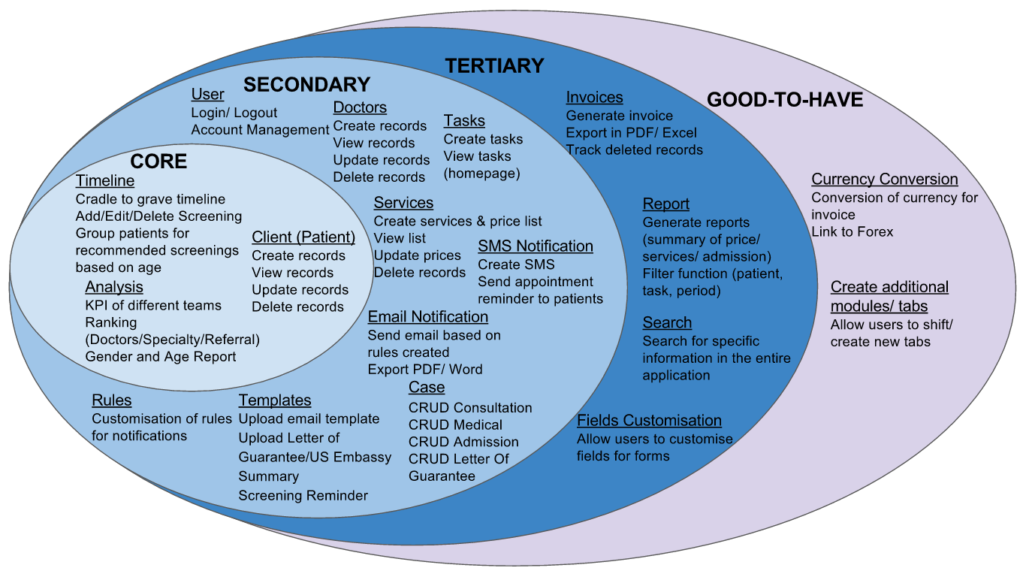
Project Management
Acceptance Scope
Introduction
Problem and Solution
Technologies
User Testing
Project Management
X-Factor
Reflections
Notes:
10/34

Slide 15
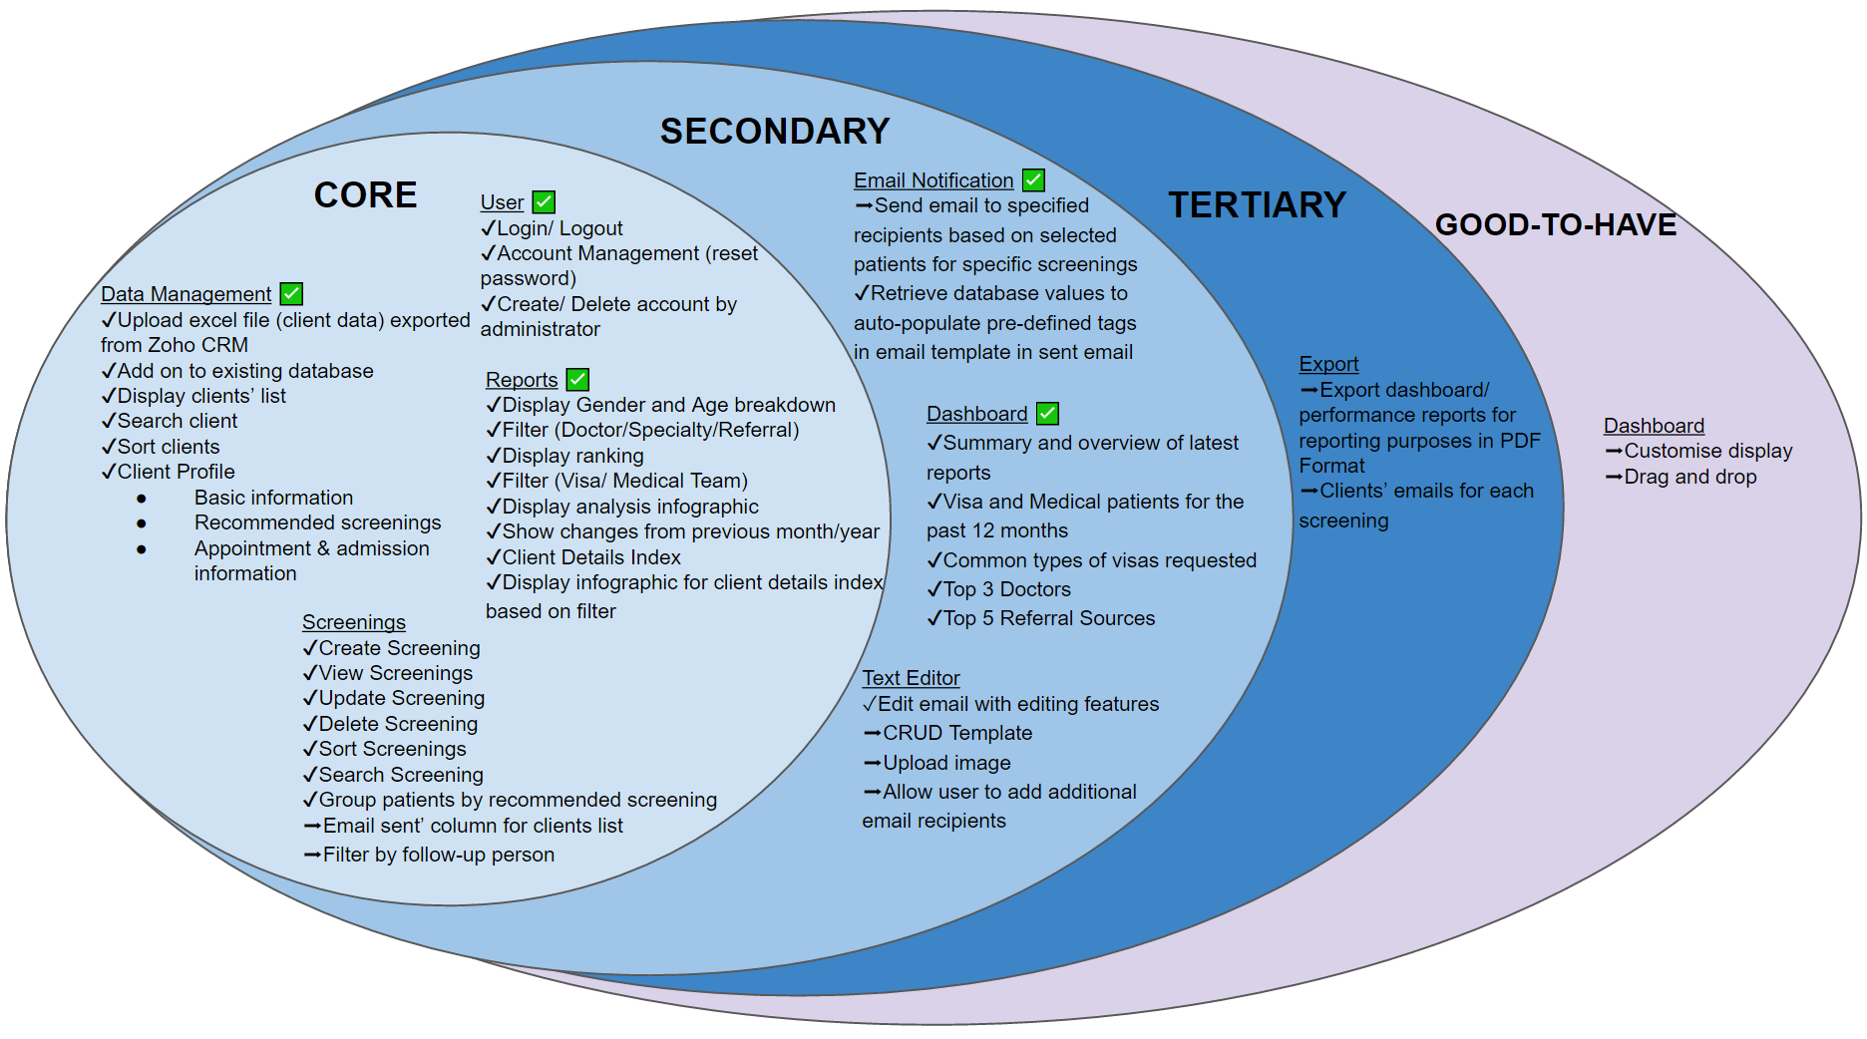
Project Management
Scope
76%
Completed
Notes:
31/41

Slide 16
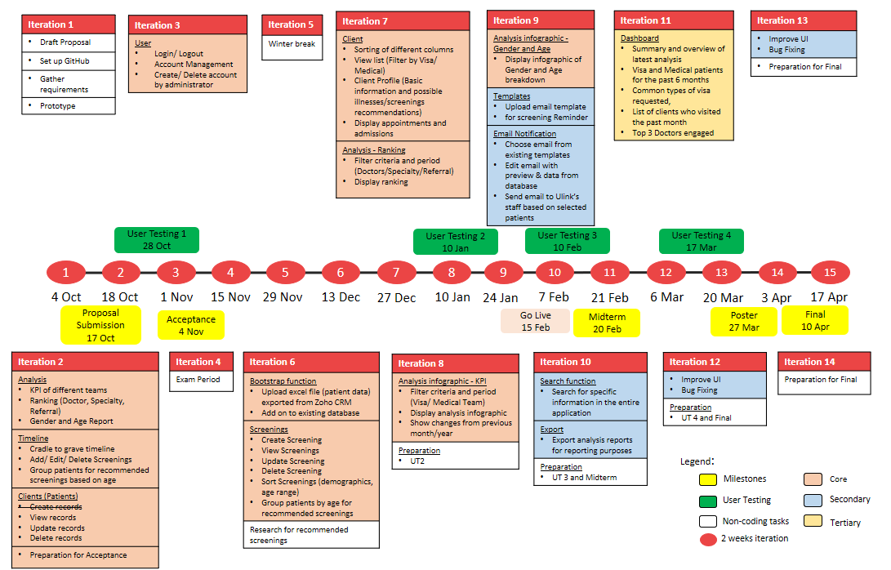
Project Management
Planned Schedule

Slide 17
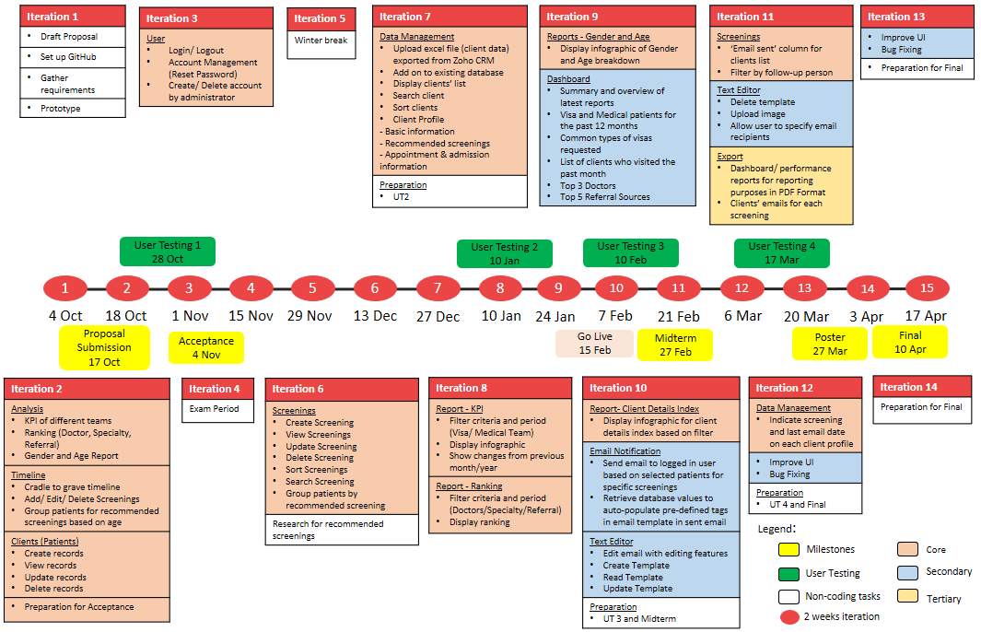
Project Management
Actual Schedule

Slide 18
Change Management

Slide 19
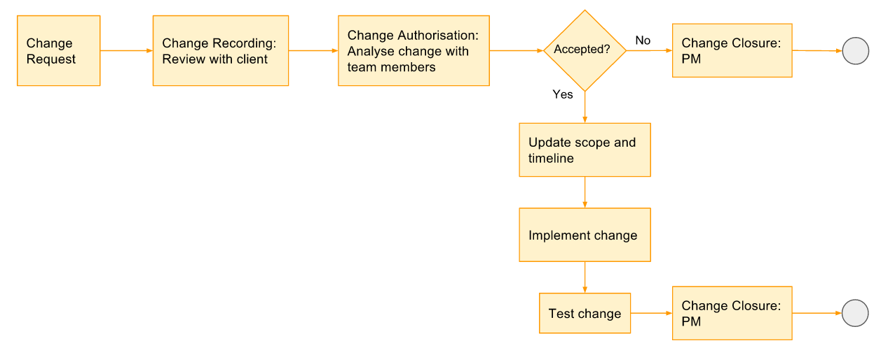
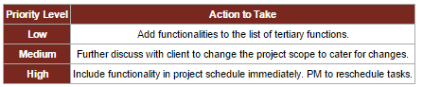
Change Management
Process

Slide 20


Change Management
Changes
Added/Modified | Removed
Report – Index (Point System) | Doctors
Database – take in additional fields from excel file | Tasks
CRUD Templates feature | Services
Text editor allows selection of recipients | SMS Notification
Text editor allows upload of images | Rules
Screenings – email sent column and follow up person filter | Invoices
Screenings – follow up person filter | Currency Conversion
Export client emails in excel | Creating additional tabs/ modules

Slide 21
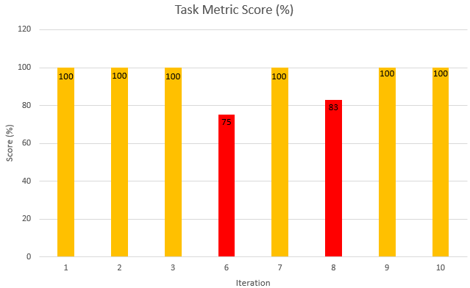
Change Management
Task Metric

Slide 22
Change Management
Task Metric
Iteration | Iteration 6 | Iteration 8
Actual : Planned (Tasks) | 6 : 8 | 5 : 6
TM Score | 75% | 83%
Problem | Bugs: Screenings Edit screenings – unable to update screenings Delete button deletes a particular screening for both genders | Bugs: Reports – KPI and Ranking Incorrect data displayed UI – date picker, filter values
Action taken | Shifted uploading data to next Iteration | Shifted Gender and Age report to next Iteration

Slide 23
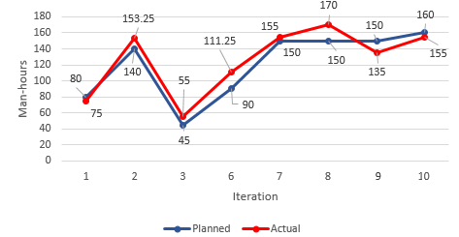
Change Management
Effort Metric
Notes:
2 – before acceptance, underestimate hours required for preparation
6 – CRUD screenings not as easy as we thought
8 – Iter 7 Ranking was shifted to iter 8. hence iter 8 has ranking and kpi functions to complete
9 – Over estimated time required for dashboard + gender and age report (more of charts and display)

Slide 24
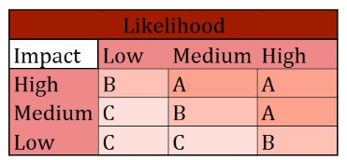
Project Management
Risk Management
Project Management Risk
Allocation of too much/ little time for development of functions
Buffer days before submission
Allocate more time for more complex tasks

Slide 25
Project Management
Risk Management
Client Risk
Change in client’s requirement
Meet and update client weekly to ensure that development is on par with client’s requirements
Present client the latest prototype on their changed requirements before development

Slide 26
Project Management
Risk Management
Project Management Risk
Unfamiliar with coding language
E,g. Javascript, JQuery
More experienced developer to share knowledge and developers to research and learn technologies required.
Assistant developer to help with complex tasks

Slide 27

Quality Assurance
Internal Testing
User Testing

Slide 28
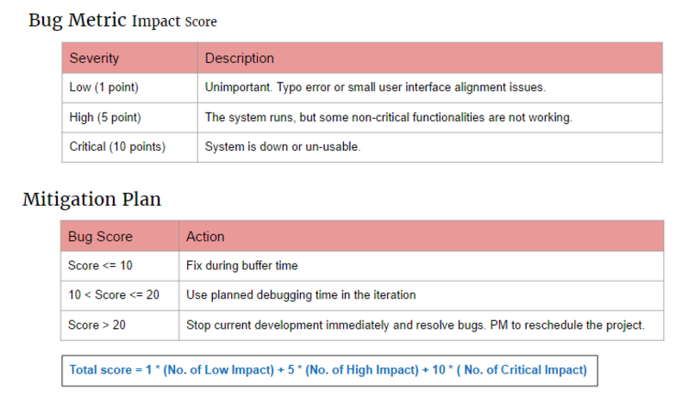
Quality Assurance
Bug Metric

Slide 29
Quality Assurance
Bug Metric
Insert update BM here

Slide 30
Quality Assurance
Bug Count by Category
Insert update Bug count by category
Crit, high, low

Slide 31
Quality Assurance
User Testing 1
Purpose: Gather UI feedback and detect usability issues
Participant: Linda (Sponsor)
Date: 28 October 2016
Time: 4.00pm
Scope:
Client Creation Module
Timeline Module
Reports Module
KPI
Ranking
Gender and Age Report
Notes:
Client prefers to choose which patient to send email to instead of automated sending of email
Analysis results to be in numbers

Slide 32


Quality Assurance
UT 1 Feedback
Easy to navigate
Timeline for screenings design is not intuitive
Naming of columns and fields are confusing
Notes:
Client prefers to choose which patient to send email to instead of automated sending of email
Analysis results to be in numbers

Slide 33
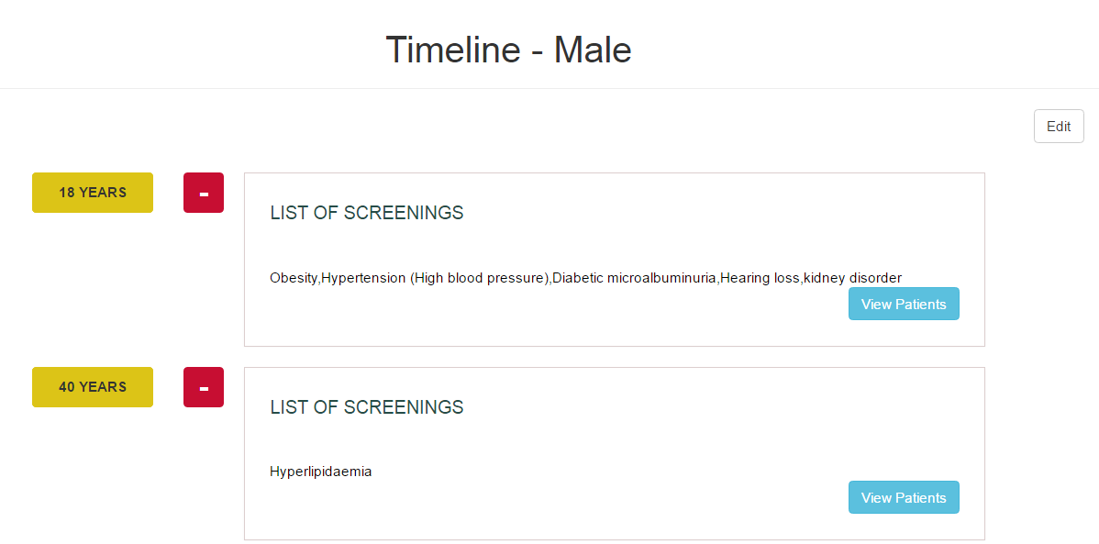
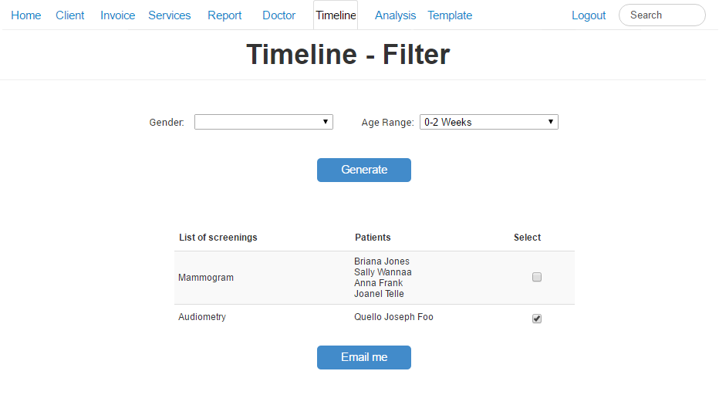

Quality Assurance
UT 1 Feedback
Timeline display is not intuitive, user suggested to change to table format
Stick to one color scheme
Client prefers to choose which patient to send email to instead of automated sending of email

Slide 34
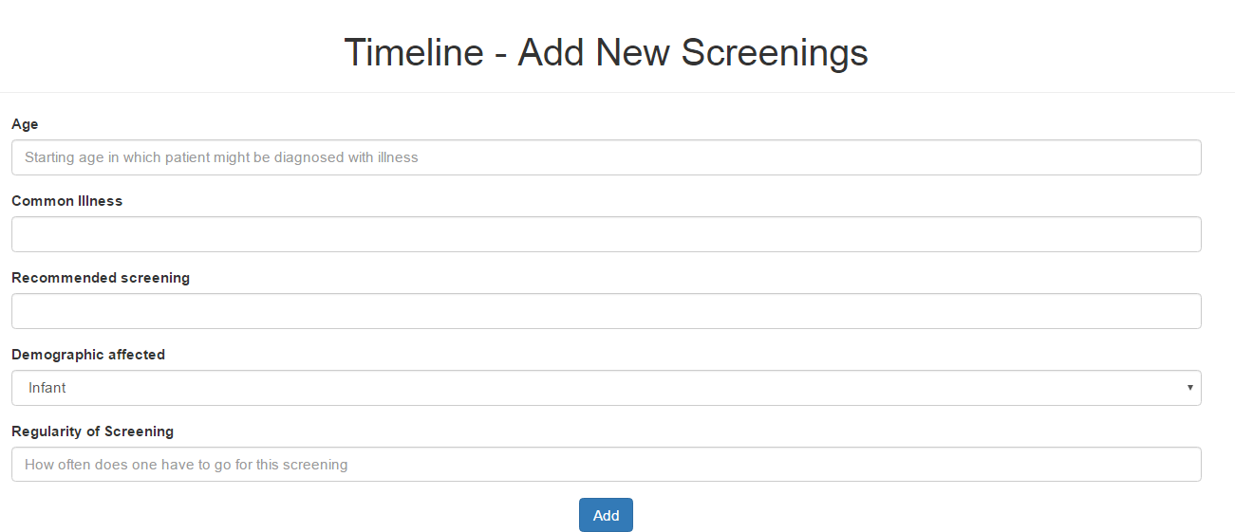
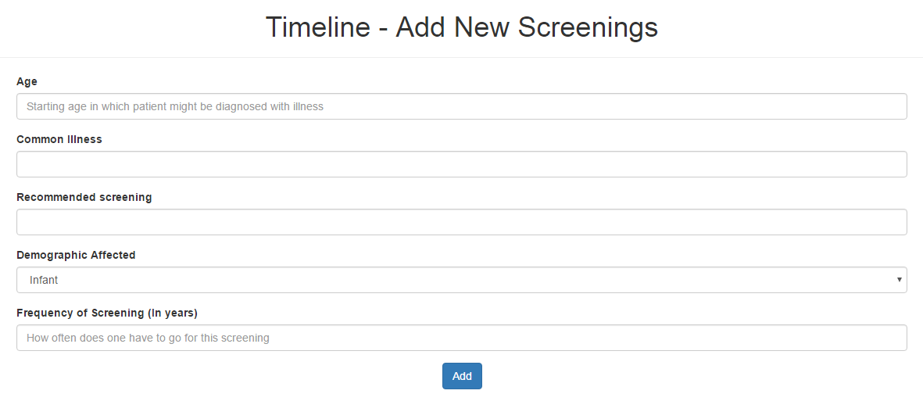
Quality Assurance
UT 1 Feedback
Rename Regularity field to Frequency of Screening (In Years) for easy understanding

Slide 35
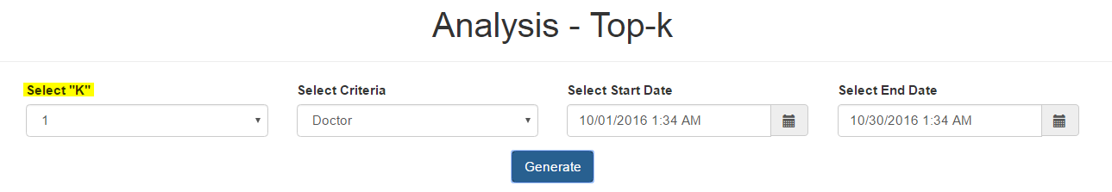

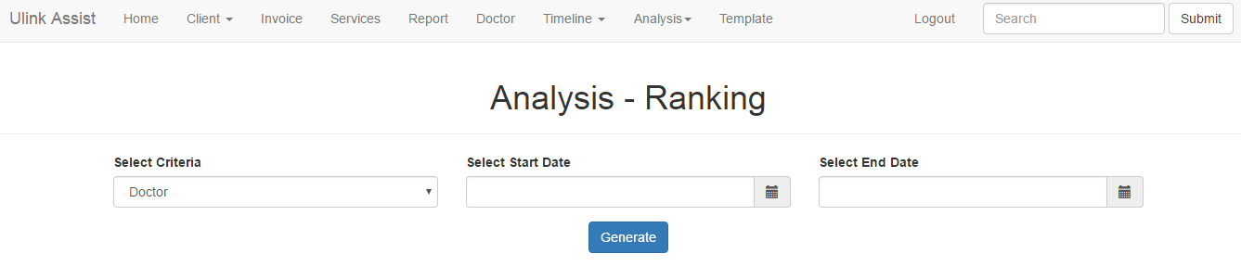
Quality Assurance
UT 1 Feedback
Top-K function to rename as "Ranking" for easy understanding
List all results in a ranked list instead of selecting “K” value
Changes Made

Slide 36
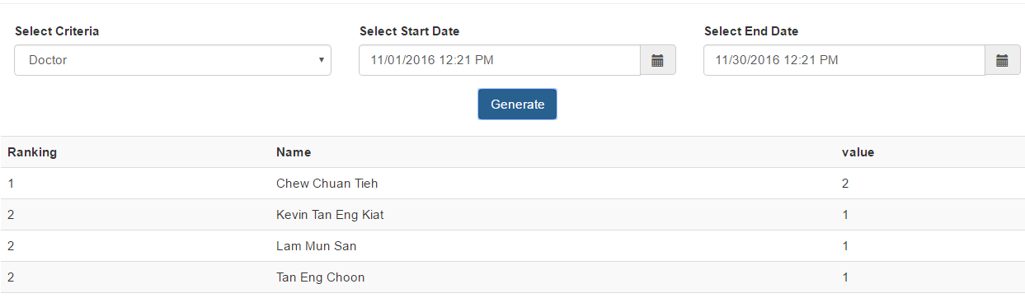
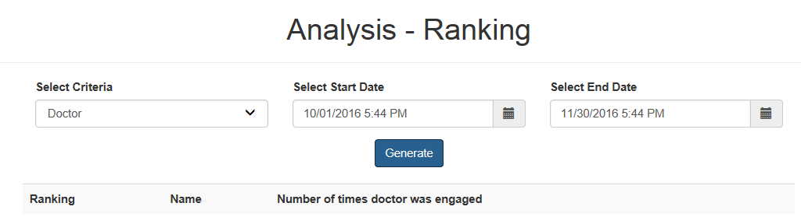
Quality Assurance
UT 1 Feedback
Confusing naming

Slide 37
Quality Assurance
User Testing 2
Usability & Heuristic Test
Purpose: Identify any usability problems and UI issues
Participant: 5 Ulink employees
Date: 10 January 2017
Time: 3.30pm
Scope:
Login/ Logout
Screenings
Client
Data Management
Notes:
Client prefers to choose which patient to send email to instead of automated sending of email
Analysis results to be in numbers

Slide 38
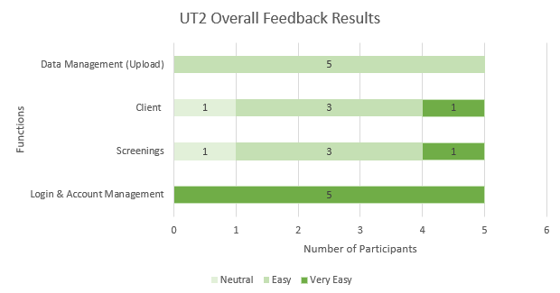
Quality Assurance
UT 2 Usability
Notes:
Client prefers to choose which patient to send email to instead of automated sending of email
Analysis results to be in numbers

Slide 39
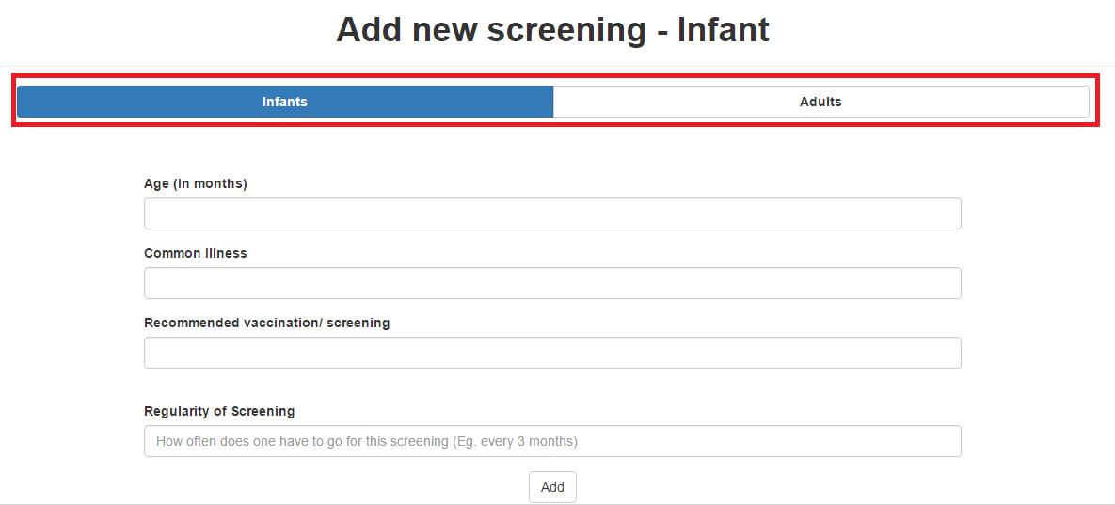
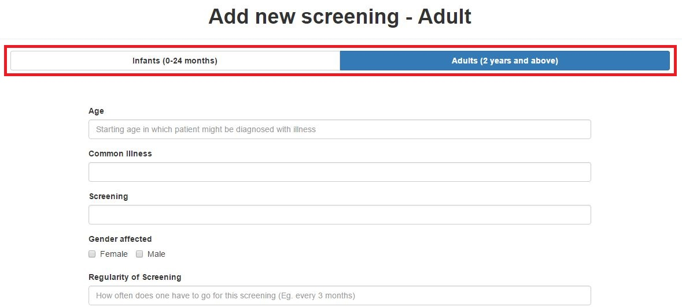
Quality Assurance
UT 2 Heuristics Improvements
Header of Screening form is not specific

Slide 40
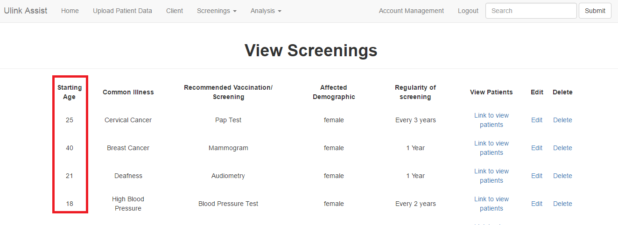
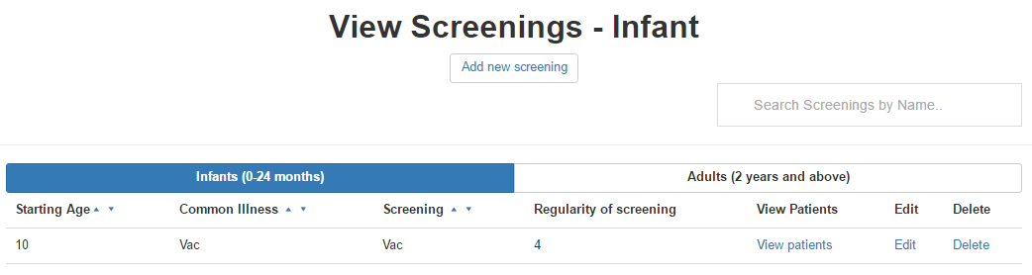
Quality Assurance
UT 2 Heuristics Improvements
Infants and Adults screenings should have different views
To prevent confusion in age (months, years)

Slide 41
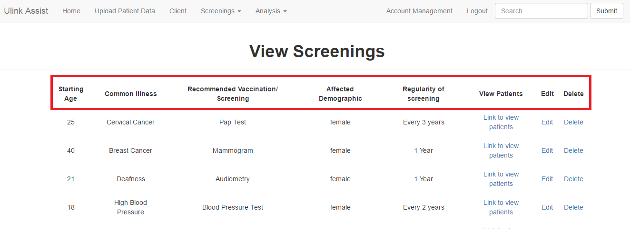
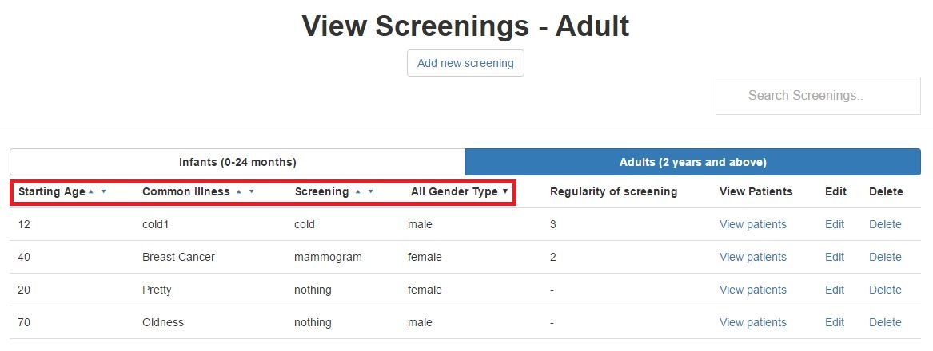
Quality Assurance
UT 2 Heuristics Improvements
Difficult to search for particular client/ screenings
Search and sort features allow easier search

Slide 42

Quality Assurance
User Testing 3
Purpose:
Gather UI feedback and detect usability issues
Measure time taken for each task
Participant: 6 Ulink employees
Date: 13 October 2016
Time: 4.30pm
Scope:
Data Management - Client Module
Dashboard Module
Reports Module
KPI
Ranking
Gender and Age
Screenings
Email Notification
Text Editor
Time taken for each task
Notes:
Client prefers to choose which patient to send email to instead of automated sending of email
Analysis results to be in numbers

Slide 43
Quality Assurance
User Testing 3 Procedure
Login
Data Management (Client)
Reports -KPI
Reports - Ranking
Gender and Age
Screening
Dashboard
Email Recommended Screenings

Slide 44
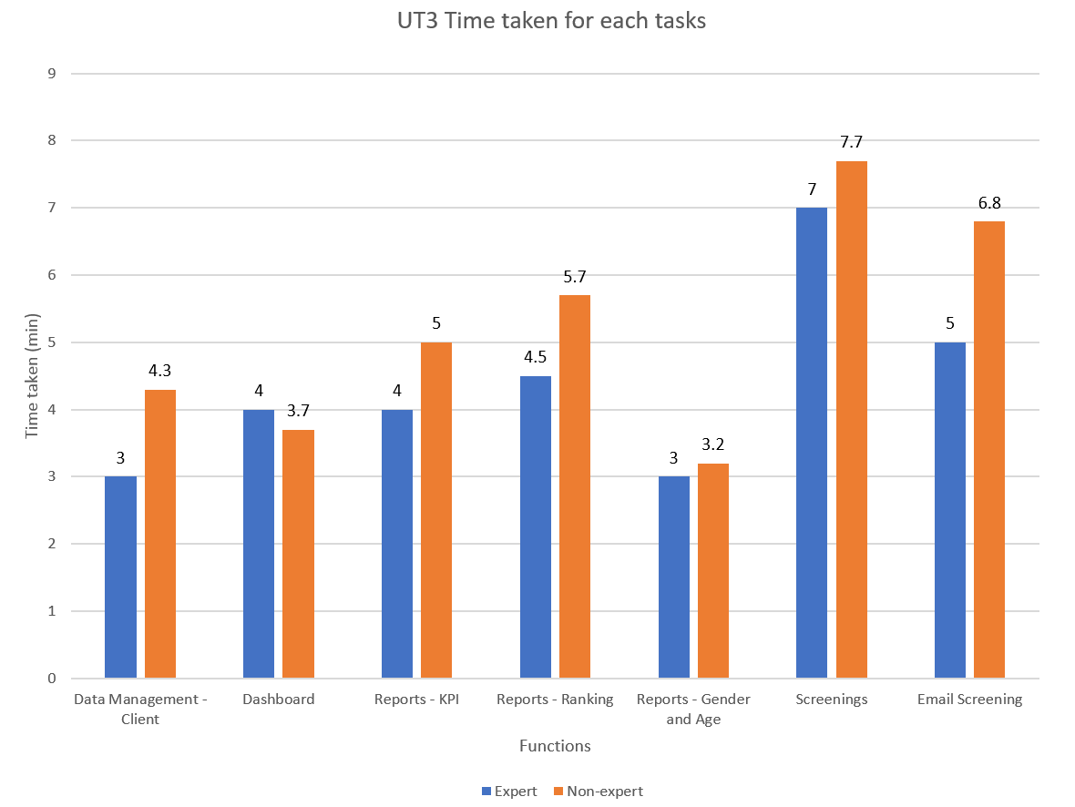
Quality Assurance
User Testing 3 Results
Non–experts should take not more than 150% of expert’s time taken
Notes:
Client prefers to choose which patient to send email to instead of automated sending of email
Analysis results to be in numbers

Slide 45
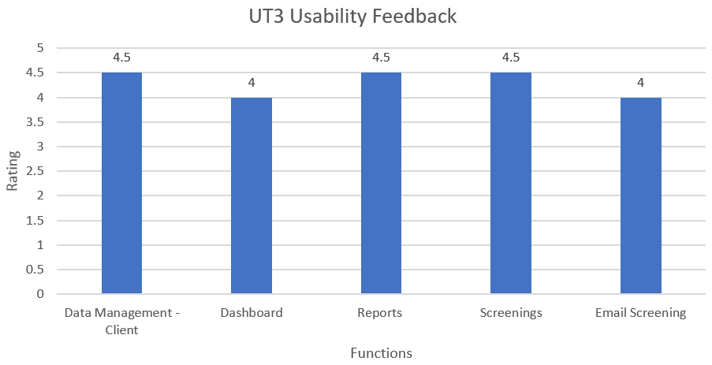
Quality Assurance
UT 3 Feedback
Notes:
Client prefers to choose which patient to send email to instead of automated sending of email
Analysis results to be in numbers

Slide 46
Quality Assurance
UT 3 Feedback
Dashboard & Reports
Visual graphs for better understanding
User interface
Straightforward and user-friendly
Notes:
Client prefers to choose which patient to send email to instead of automated sending of email
Analysis results to be in numbers

Slide 47
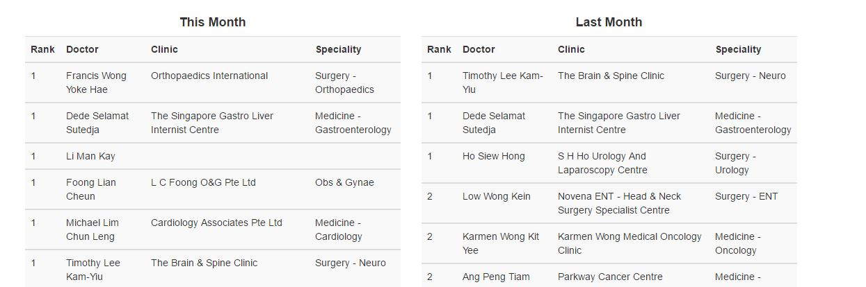
Quality Assurance
UT 3 Feedback
Change header to be more specific
Notes:
Client prefers to choose which patient to send email to instead of automated sending of email
Analysis results to be in numbers

Slide 48
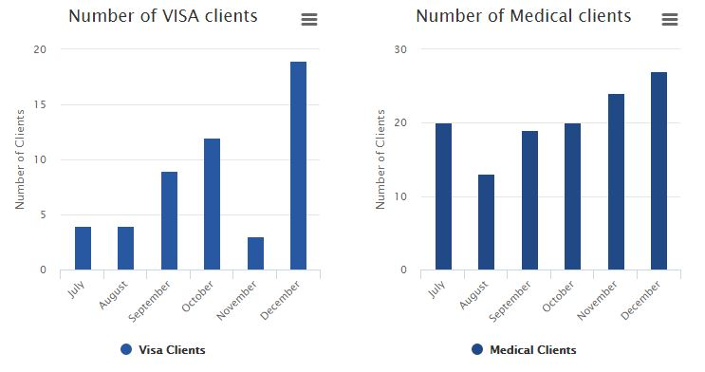
Quality Assurance
UT 3 Feedback
Include data labels
Notes:
Client prefers to choose which patient to send email to instead of automated sending of email
Analysis results to be in numbers

Slide 49
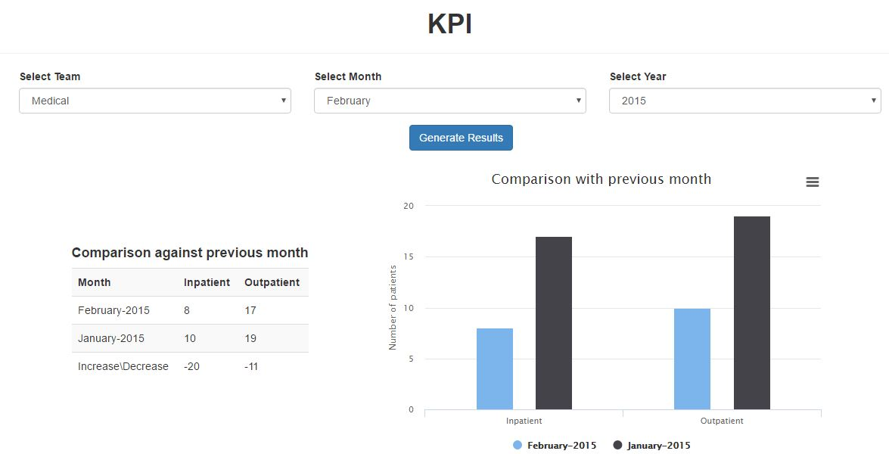
Quality Assurance
UT 3 Feedback
Include % sign for increase/ decrease in performance
Notes:
Client prefers to choose which patient to send email to instead of automated sending of email
Analysis results to be in numbers

Slide 50
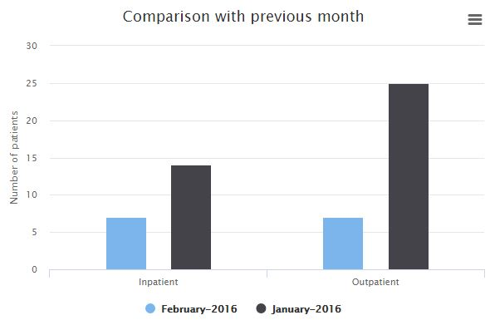
Quality Assurance
UT 3 Feedback
Display earlier month/ year on the left of the graph

Slide 51
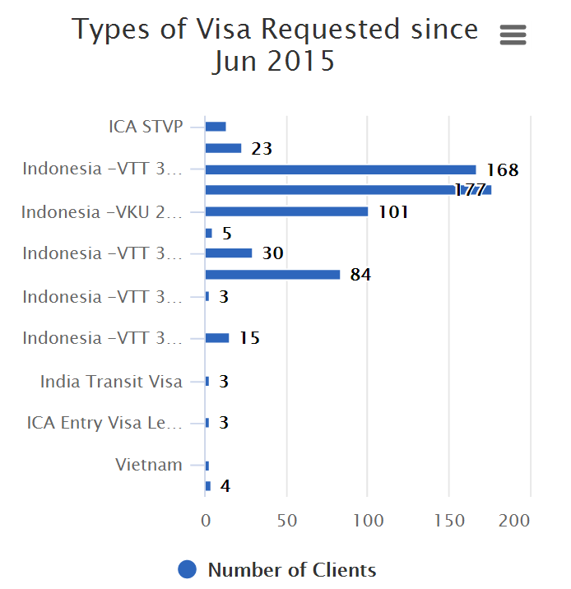
Quality Assurance
UT 3 Feedback
Unclear of which period this graph is referring to

Slide 52
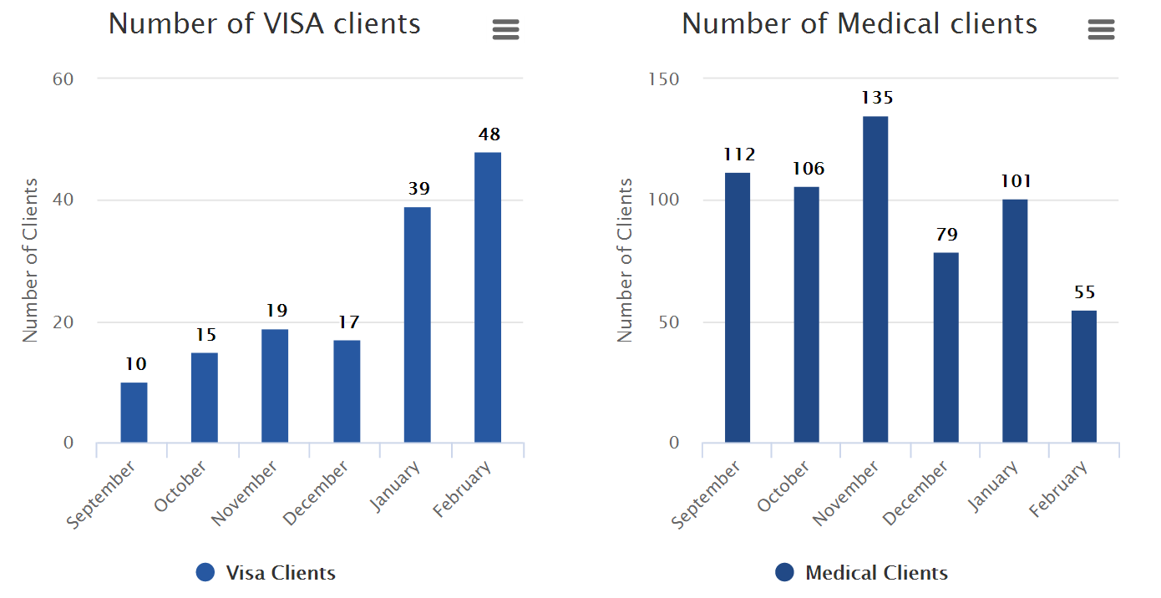
Quality Assurance
UT 3 Feedback
Data labels added

Slide 53

Quality Assurance
UT Takeaways
Gather perspective and opinions of different users’
Continuously work on improving the functions

Slide 54
X-FACTOR
Midterm
At least 25 out of 50 Client’s responses via email
Final
User Interactions
At least 30 reports generated/ exported

Slide 55
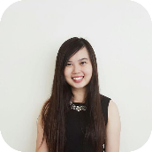




Reflections
Shu yan
nicole
I have learnt the importance of conducting User Testing and different users have different expectations of the system
I am more familiar with front-end development and feedback from users are very important to me as they help to make the UI more user-friendly
Sean
Learnt to prioritise changes and adopt suggestions from user so that we can improve the system
Kaixin
Nabilah
Knowing how to prepare for change and understanding business requirements is important to deliver a good product
In addition to gathering user requirements, I’ve also learnt more about front-end development as an assistant front-end developer

Slide 56

Thank you

